Slide 1

3. Django models (Working with database and queries)
Md. Nahiyan Uddin
Lecturer
Department of CSE
University of Asia Pacific

Slide 2
Objectives
Designing the Schema diagram
DB browser to browse our database
Creating the models
Writing the model classes
Running the migration command in terminal
Adding data into the database tables
Running queries

Slide 3
Designing the Schema diagram
My schema diagram design-
User(id, username, password, email, first_name, last_name, date_joined, last_login, is_superuser, is_staff, is_active)
UserProfile(id, phone_no, profile_picture, date_of_birth, User.id)
Student(student_id, cgpa, semester, UserProfile.id)
VCAward(id, session, Student.student_id)
Teacher(id, designation, UserProfile.id)
Course(id, code, name)
AssignedCourse(id, Course.id, Teacher.id, session)
* Italic font means foreign key

Slide 4
Default Models
In Django we have some models already prewritten.
Among them, the most important one is “User” model.
We can import it from django.contribe.auth.models module

Slide 5
DB Browser for SQLite
This will help us view our database.
We can download it from the following link.
https://sqlitebrowser.org/dl/

Slide 6
Creating the models
Writing the model classes-
Let’s look at some examples -

Slide 7
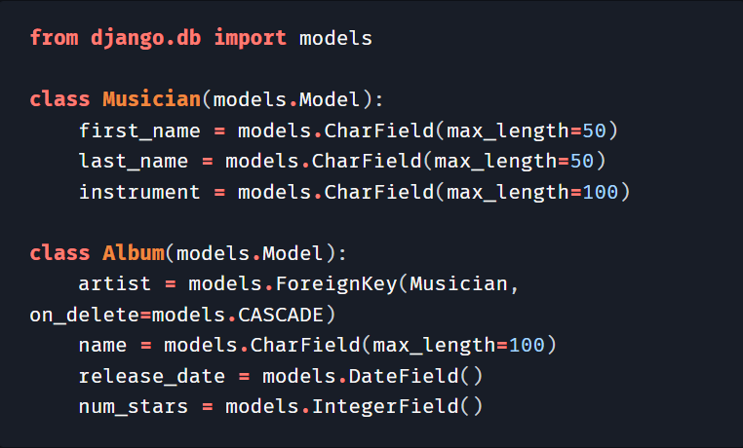
Models
Creating two database tables-
Musician
first_name
last_name
instrument
Album
artist
name
release_date
num_stars

Slide 8
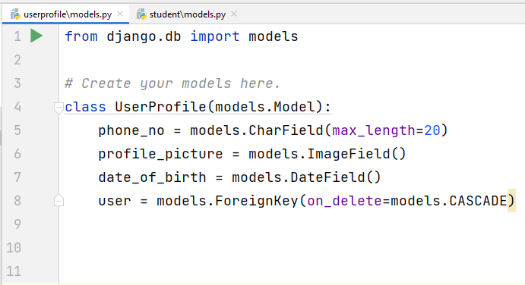
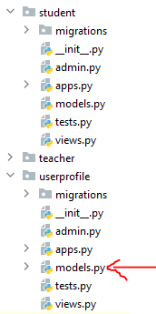
Our UserProfile and Student models-

Slide 9
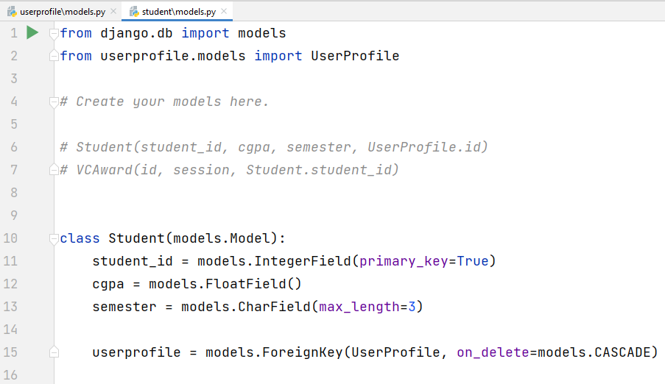
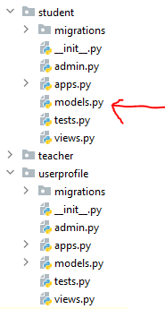
Our UserProfile and Student models-

Slide 10


Working with images
For medias uploaded by the user
Add a folder named “media” in the project root directory
Add the following two lines in setting.py file-
these lines will add the path to the MEDIDA_ROOT
For images that are static –
Add a folder named “static” under each app directory
Add the following line in setting.py file
this line will add the path to the STATIC_ROOT
Install pillow –
$ pip install pillow

Slide 11
Objectives
Designing the Schema diagram
DB browser to browse our database
Creating the models
Writing the model classes
Running the migration command in terminal
Adding data into the database
Running queries

Slide 12
Running the migration command in terminal
Commands to make migrations and migrate
$ python manage.py makemigrations
$ python manage.py migrate
This is store the changes in the database

Slide 13
Objectives
Designing the Schema diagram
DB browser to browse our database
Creating the models
Writing the model classes
Running the migration command in terminal
Adding data into the database
Running queries

Slide 14
Official Django Documentations
Official Django Documentations-
Models - https://docs.djangoproject.com/en/4.1/topics/db/models/
Making Queries- https://docs.djangoproject.com/en/4.1/topics/db/queries/
Performing raw SQL queries - https://docs.djangoproject.com/en/4.1/topics/db/sql/

Slide 15
Fields Types
All field options - https://docs.djangoproject.com/en/4.1/ref/models/fields/#field-types

Slide 16
Fields Types - Data types
Frequently used fields-
CharField(max_length=None, **options)
DateField(auto_now=False, auto_now_add=False, **options)
DateTimeField(auto_now=False, auto_now_add=False, **options)
DecimalField(max_digits=None, decimal_places=None, **options)
EmailField(max_length=254, **options)
FileField(upload_to='', storage=None, max_length=100, **options)
FilePathField(path='', match=None, recursive=False, allow_files=True, allow_folders=False, max_length=100, **options)
FloatField(**options)
ImageField(upload_to=None, height_field=None, width_field=None, max_length=100, **options)
TextField(**options)

Slide 17
Fields Types - Relational Fields
ForeignKey(to, on_delete, **options)
ManyToManyField(to, **options)
OneToOneField(to, on_delete, parent_link=False, **options)

Slide 18
Adding data to the Database
Create an object of the class.
Then call the save() method of that object.
Example-
We have model class name Student-
Student(student_id, cgpa, semester, UserProfile.id)
These two lines will add a student row in the Student Table-
s = Student(student_id=‘14051002’,cgpa=3.50,semester=‘3-1’,user.id=1)
s.save()

Slide 19
Objectives
Designing the Schema diagram
DB browser to browse our database
Creating the models
Writing the model classes
Running the migration command in terminal
Adding data into the database
Running queries

Slide 20
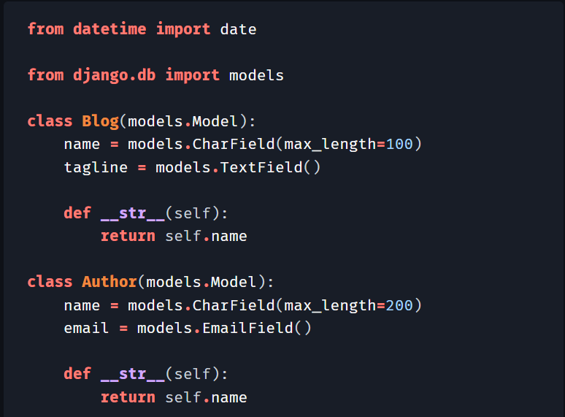
Running Queries
We have to learn to do CRUD operation-
C – Create
R – Read
U – Update
D – Delete

Slide 21
Using the shell
We can create a test.py file inside the project root folder and use it to run our code-
Or we can Open the Django shell in the terminal and test our code there
To open the shell-
$ python manage.py shell

Slide 22
Create
Creating objects
s = Student(student_id=‘14051002’,cgpa=3.50,semester=‘3-1’,user.id=1)
s.save()

Slide 23
Read
Running Queries –
https://docs.djangoproject.com/en/4.1/topics/db/queries/#retrieving-objects
Running Queries –
https://docs.djangoproject.com/en/4.1/topics/db/queries/#retrieving-objects
Retrieving objects
Retrieving all objects
Retrieving specific objects with filters
Chaining filters
Filtered QuerySets are unique
QuerySets are lazy
Retrieving a single object with get()

Slide 24
Read
These two documentations are the most helpful
https://docs.djangoproject.com/en/4.1/topics/db/queries/
https://docs.djangoproject.com/en/4.1/ref/models/querysets/#field-lookups

Slide 25
Update
Saving changes to objects
s = Student.object.get(student_id=‘14051002’)
s.cgpa = 3.95
s.save()

Slide 26
Delete
Deleting a row-
s = Student.object.get(student_id=‘14051002’)
s.delete()

Slide 27
Objectives
Designing the Schema diagram
DB browser to browse our database
Creating the models
Writing the model classes
Running the migration command in terminal
Adding data into the database
Running queries

Slide 28


